Slide 1
Unix - Final Project Hosting a website & DDoS https://veaci.ca
Teacher: Sakkaravarthi Ramanathan
Team Members: Danich Hang Madalina Turcan Veaceslav Vlas

Slide 2
How did you determine which features to include?
By going step by step: 1. Virtual private server (VPS) 2. Users along with the ssh keys 3. Idea to link a domain to our VPS 4. Get a SSL certificate as well, to have the user’s trust when he accesses our website.

Slide 3
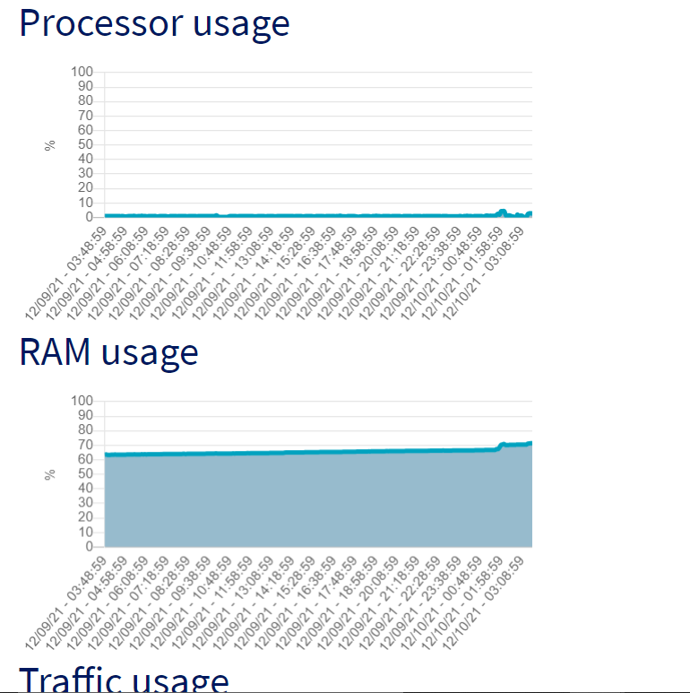
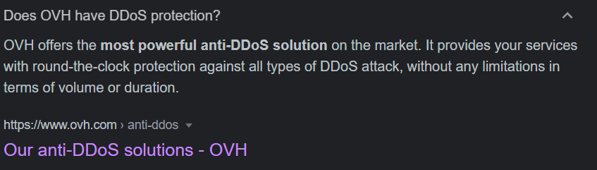
How did you choose which to exclude?
We decided to exclude features such as Server Health Monitoring since OVHcloud has a built-in system ready to go even at the lowes tiers of subscriptions.
And finally, after multiple attempts, we realised that we didn’t needed custom DDoS Protection since, quote:

Slide 4

How did you choose which technologies to use?
By going with the ones that have the most support and documentation available, e.g. OVHcloud was chosen because the recommendation, and documentation available. Ngnix its popularity and ease of use on Linux platform
GoDaddy for a cheap 1$ domain for a year SSLforFree for ease of getting a certificate plus it’s FREE

Slide 5
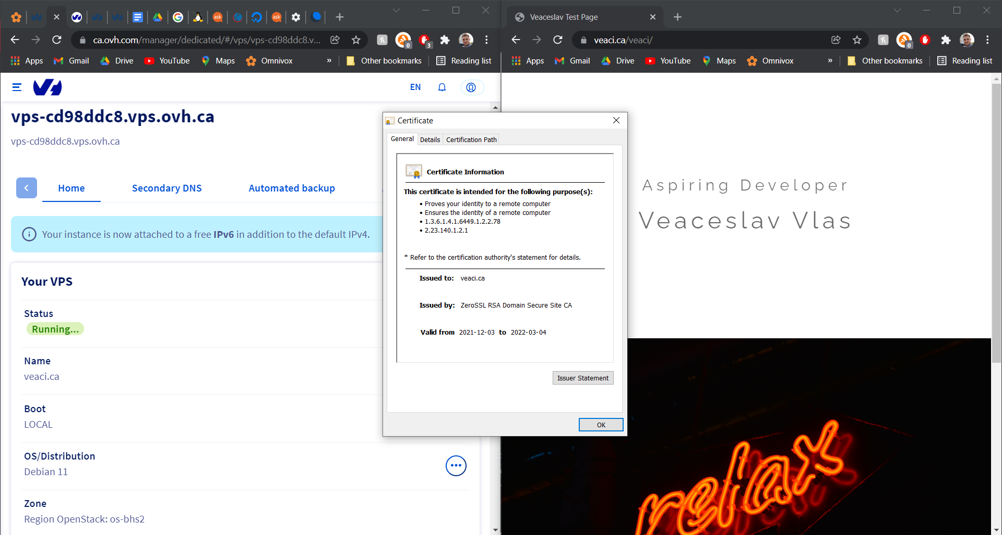
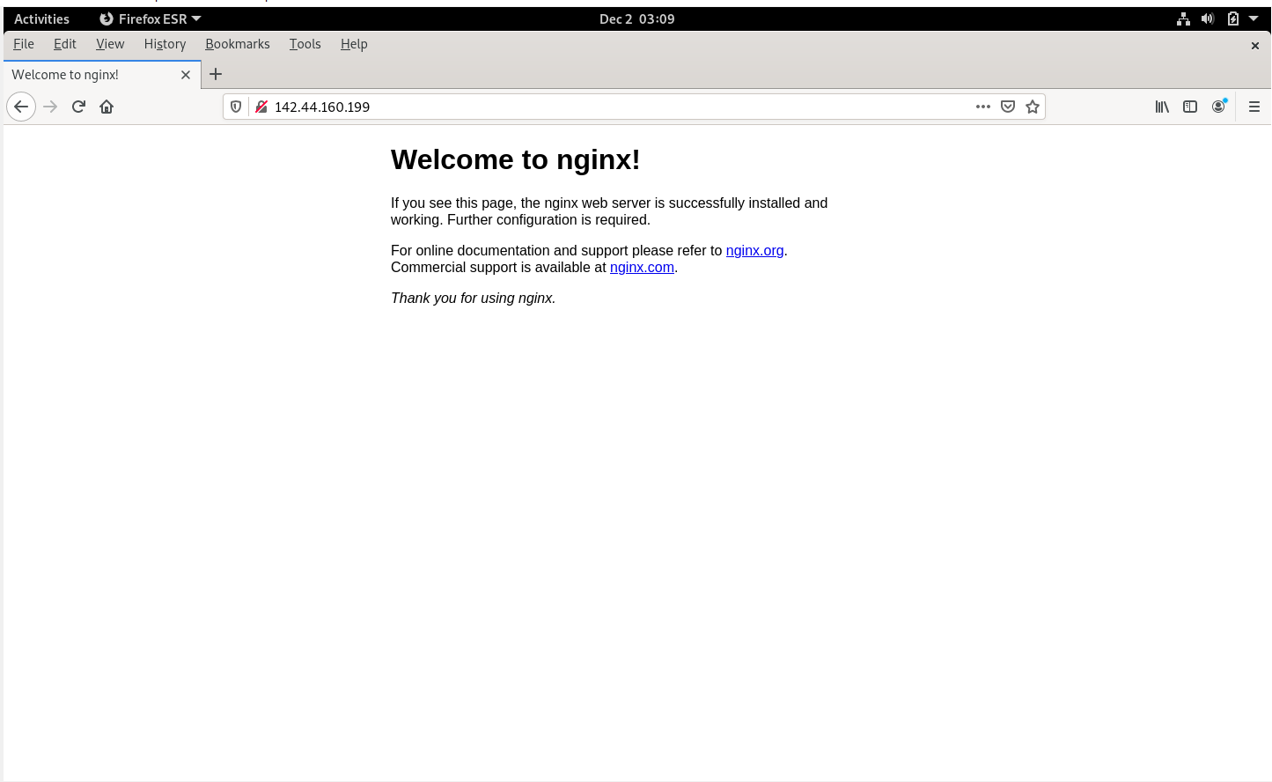
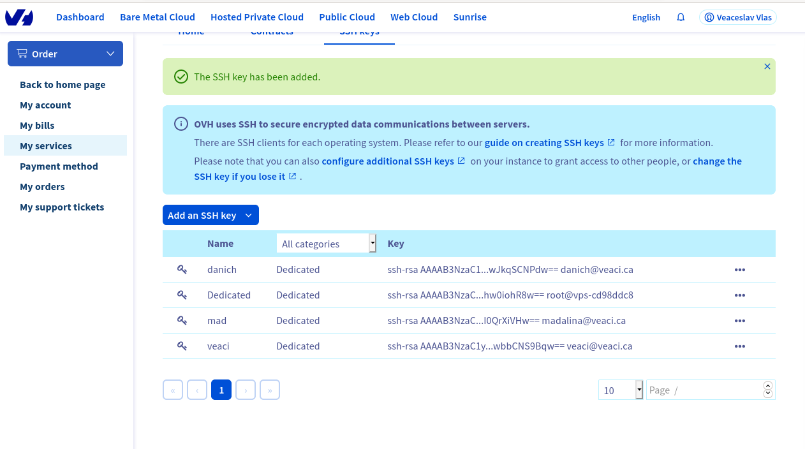
How did you divide the work among your team?
OVHcloud, GoDaddy, SSLforFree: Veaceslav Ngnix, SSH: Danich & Madalina DDoS Attack Attempt: All team Members Reports & PPt: All Team Members

Slide 6
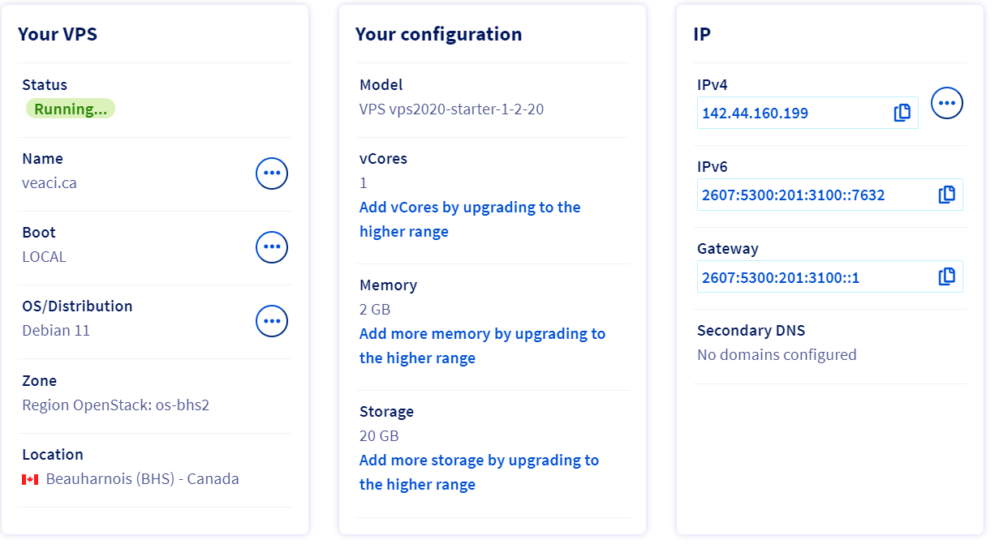
How did Covid and working remotely affect your process.
We didn’t feel that working remotely or Covid restrictions affected our performance or ability to have online meets and get work done.

Slide 7
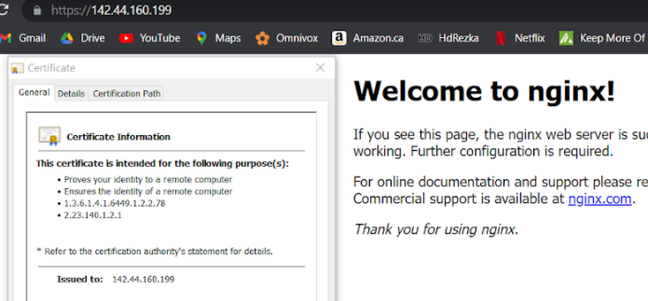
What were some major difficulties that you have to overcome?
Try multiple DDoS attack tools to finally realize that OVHClouh has one of the best Anti-DDoS Systems on the market even for the lowest subscription available. Getting an SSL for the IP address then having to change it for an SSL cert. For the domain name.
Ensure that all http requests be redirected to https.

Slide 8
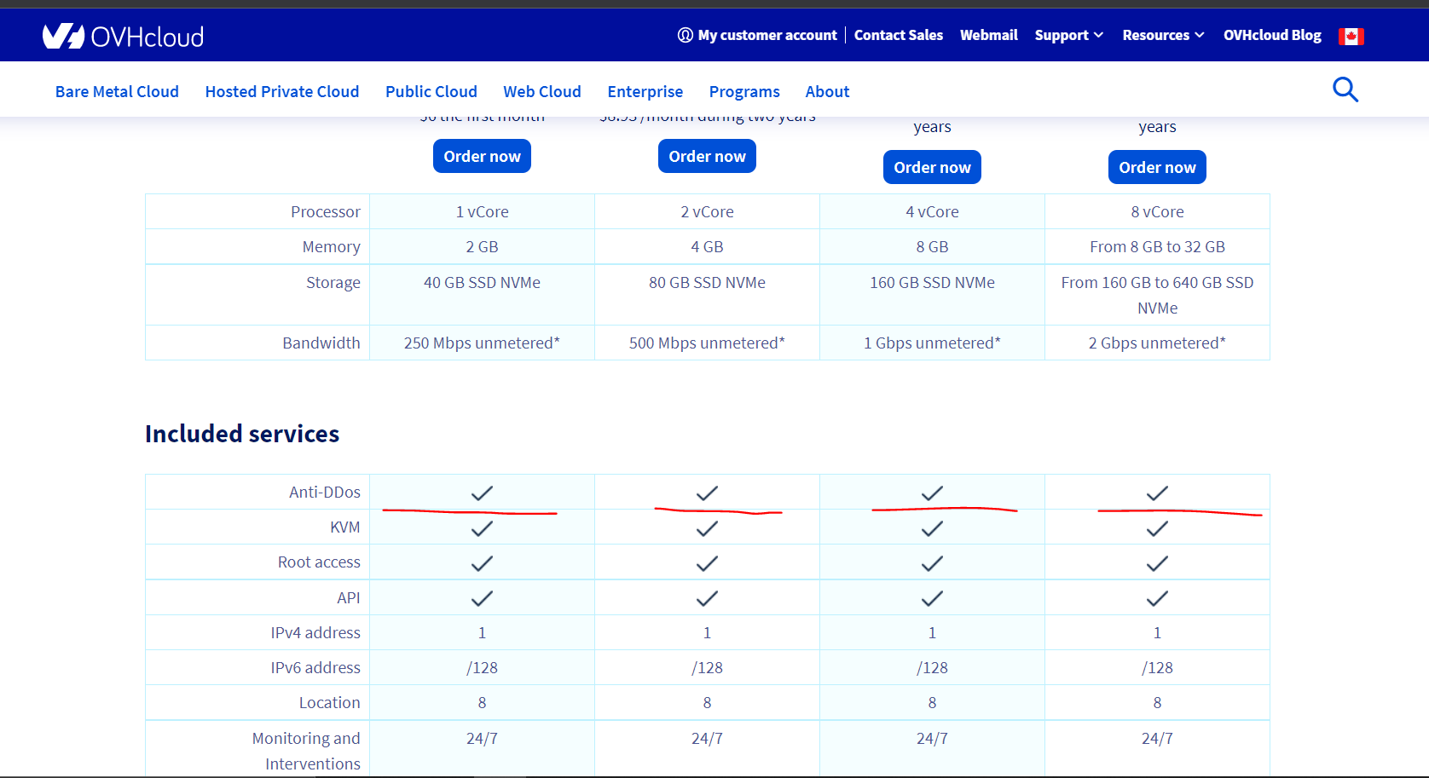
What went easier than expected?
Finding DDoS attack tools and the proper protection Multiple projects available for DDos on GitHub Sometimes you’re better of using a service rather than reinventing the wheel

Slide 9
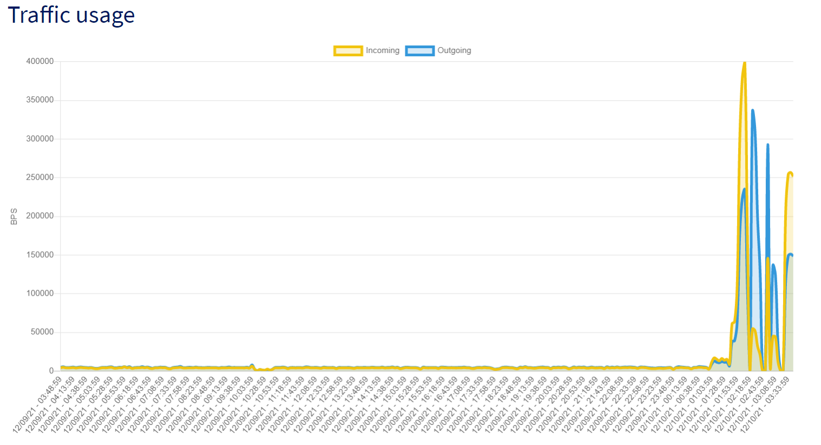
Are there any decisions you regret?
Trying multiple DDoS attack tools with multiple attempts to finally realize that OVHClouh has one of the best Anti-DDoS Systems on the market even for the lowest subscription available.

Slide 10

How did you deal with git conflicts?
To prevent such conflicts, working in separate isolated branches will resolve the matter.
The Git merge command then combines separate branches and resolves any conflicting edits.

Slide 11
Show Time
VEACI.CA
OVHcloud

